Slide 1


Workshop Focus & Objectives
Stéphane Boyera
CEO
stephane@sbc4d.com
SBC4D – http://www.sbc4d.com

Slide 2

Overview
Principles of farmer profiling
Data collection and update model
Workshop objectives
Workshop agenda

Slide 3
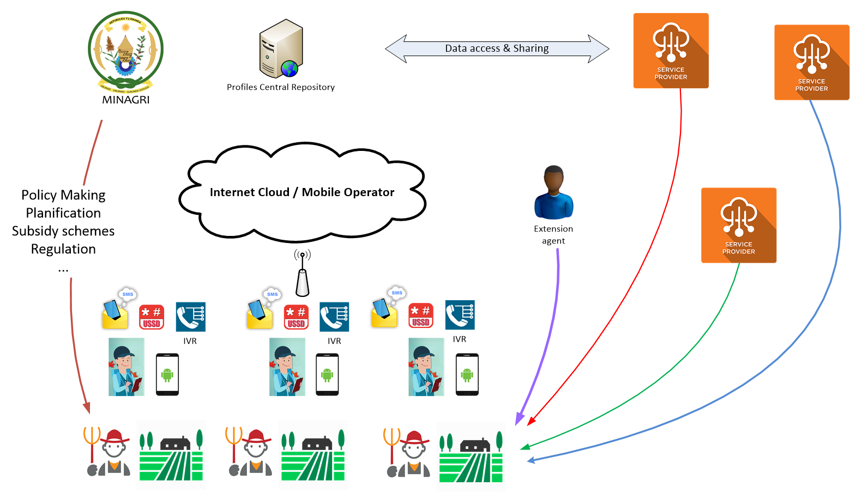
Principles of Farmer Profiling

Slide 4
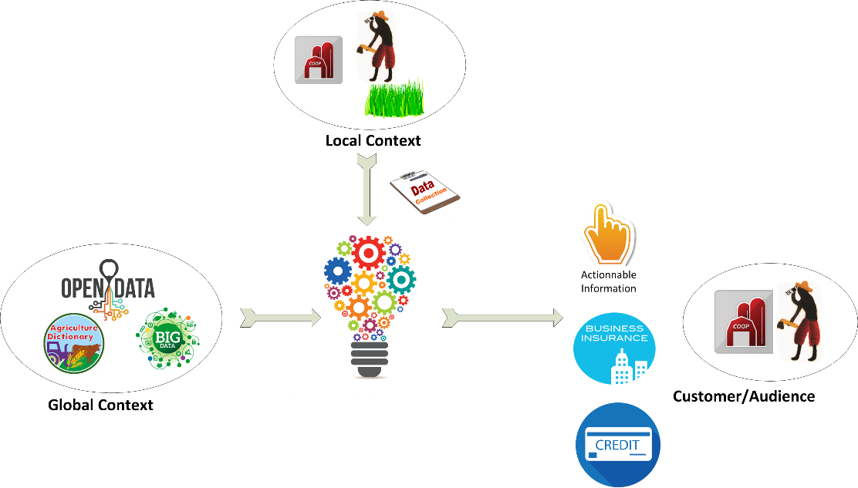
Principles of Farmer Profiling (2)

Slide 5
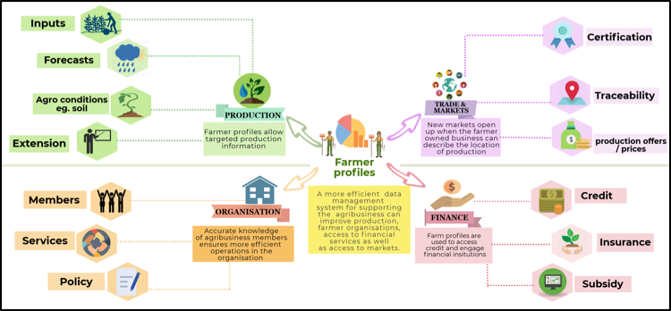
Services leveraging farmer profiles

Slide 6

Farmer profiling expected impact
Better policy based on real data
Greater access to financial services by smallholder farmers
Easier access to extension and trade services
Greater yields
Greater income

Slide 7

Building blocks
Profile content
  Which information needed for which services?
Data collection and update model
Technical platform
Business model

Slide 8

Challenge of data collection & update model
Who can do the in-person data collection (capacities, availability, incentives, equipment,…) and how?
How to ensure trust and contribution from farmers?
How to update data on regular basis?
  Who
  How (technologies/process/…)
How to verify data?

Slide 9

Objectives of the workshop
Identify a workable data collection process
  Awareness raising process
  Trust building
  People: Training, Equipment, Incentives
  Technology
Identify a workable data update model
  Incentives for farmer-driven update?
  People: Farmer promoters, youth volunteer, ICT ambassadors, youth in agriculture,…
    Profile & equipment
  Technology
  Timing

Slide 10

Workshop Agenda
Presentations of examples of data collection and update model
  SNS example
  Loda example
Group work on data collection & update model

Slide 11
Workshop Agenda (2)
09:50 - 10:10 - SNS model (RAB)
10:10 - 11:25 - Breakout session
11:25 – 11:40 – Coffee Break
11:40 - 12:40 - Debriefing
12:40 - 13:40 – Lunch
13:40 – 14:00 – Presentation of Loda household profiling
14:00 – 15:00 - Workshop output and next steps
15:00 - End of workshop

Slide 12
Breakout Session topics
How to mobilize farmers and ensure they provide accurate information?
  What could be the incentives/blocking factors for farmers to contribute proactively?
Who are the most appropriate enumerators (local or external enumerators)?
  Training requirements & Ability to use advanced ICT equipment (tablet & survey software)?
How to update profile data?
  What are point of contacts between farmers and MINAGRI, and what are capacities, equipment and availability of connectivity for each
    Extension agents, Farmer promoters, ICT Ambassadors, Call center,…
What are potential incentives for farmers to proactively provide data update?
  Subsidies, government insurance, subsidized loans, extension service, call center,…
  Who is the point of contact for updating profile information?

Slide 13


